Slide 1
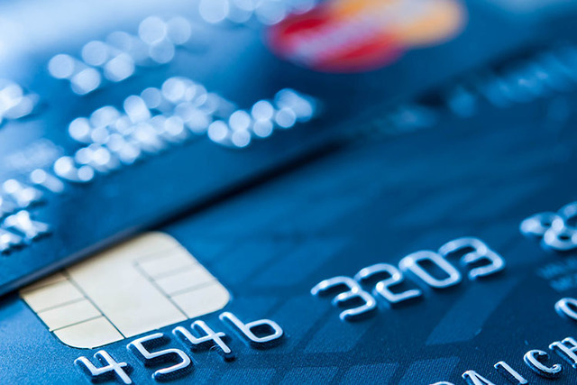
CREDIT CARD FRAUD DETECTION
SUBMITTED BY
PRIYANKA BULLA pbulla@hawk.iit.edu
SNEJA SHAH sshah187@hawk.iit.edu

Slide 2
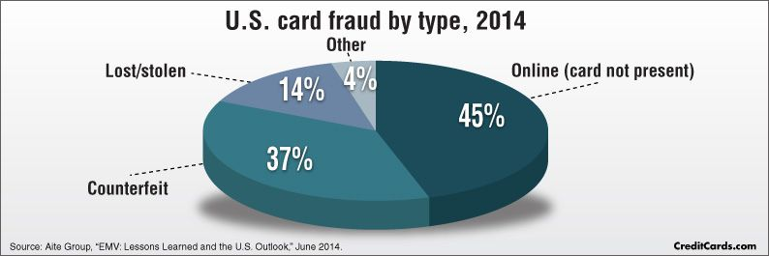
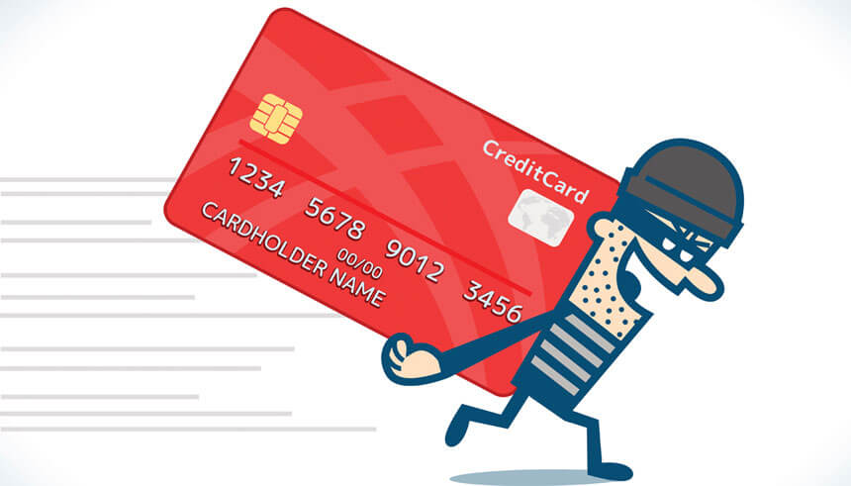
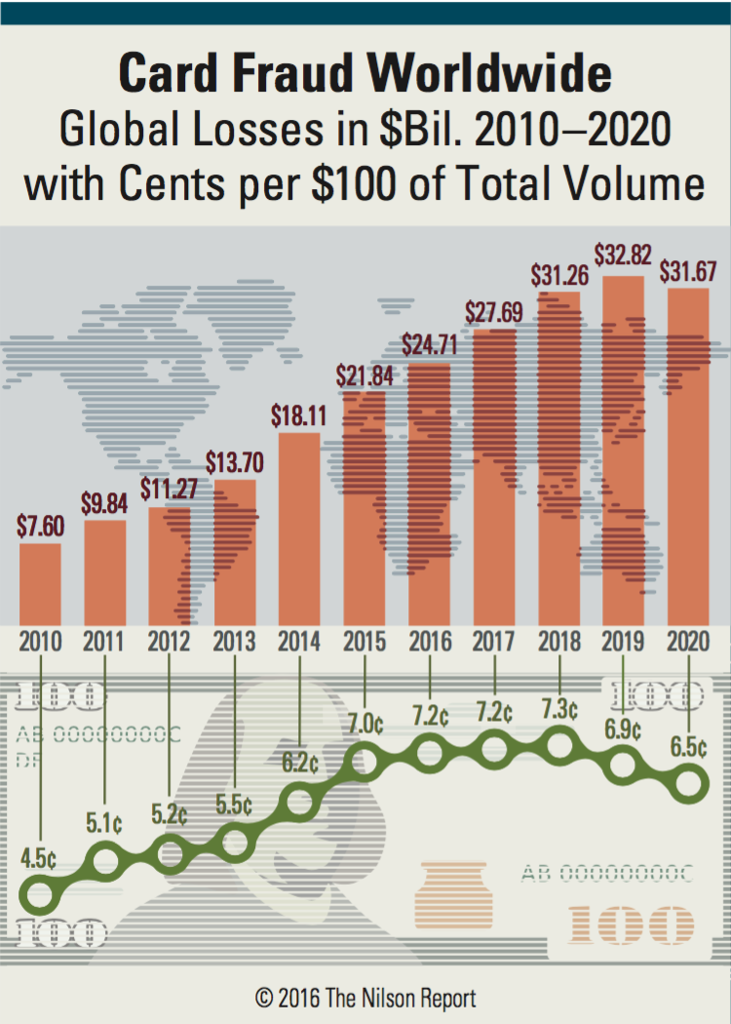
W H A T I S C R E D I T C A R D F R A U D?
DO YOU WORRY ABOUT CREDIT CARD FRAUD HAPPENING TO YOU ??
TYPES OF CARD FRAUD
M O D E R N D A Y P I C K – P O C K E T I N G

Slide 3


D A T A S E T
SOURCE
DATASIZE
VARIABLES
1
2
3
284807 row x 31 columns
284807 ROWS
X
31 COLUMNS
V1-V28 – PCA components
of the original variables
Time - Number of seconds elapsed between this
transaction and the first transaction in the dataset
Amount – Transaction
amount
Class – Target Variable
https://www.kaggle.com/mlg-ulb/creditcardfraud

Slide 4
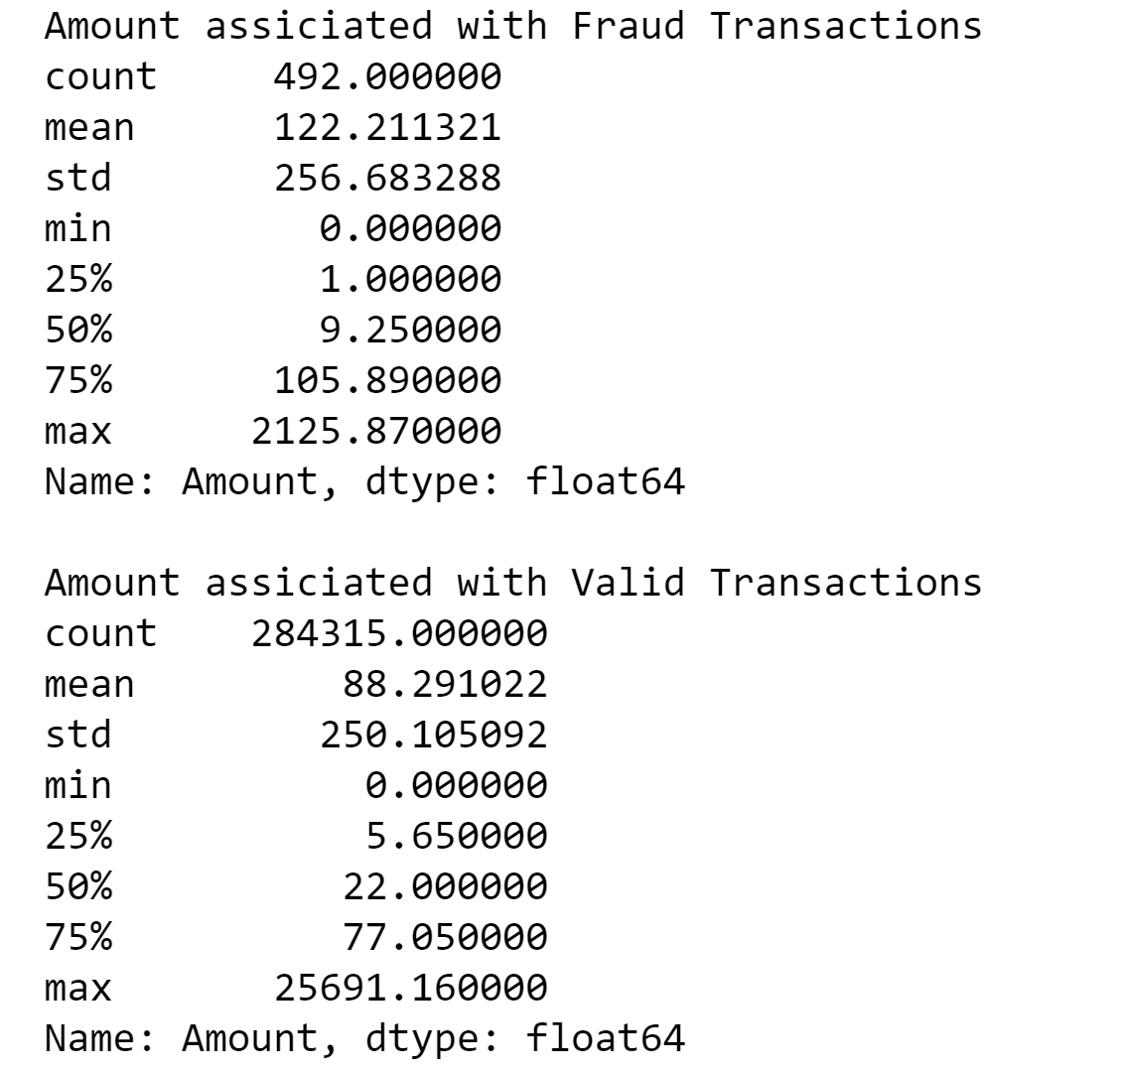
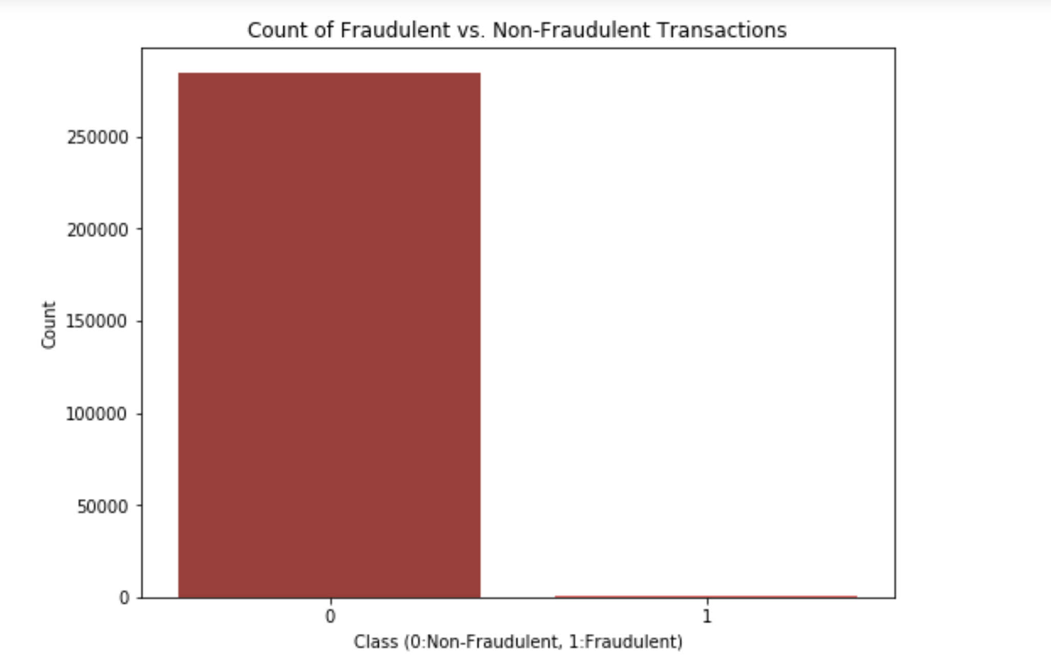
DETECT FRAUD TRANSACTIONS
IMBALANCE ISSUE IN THE DATASET
P R O B L E M S
T O B E
S O L V E D
2
1

Slide 5
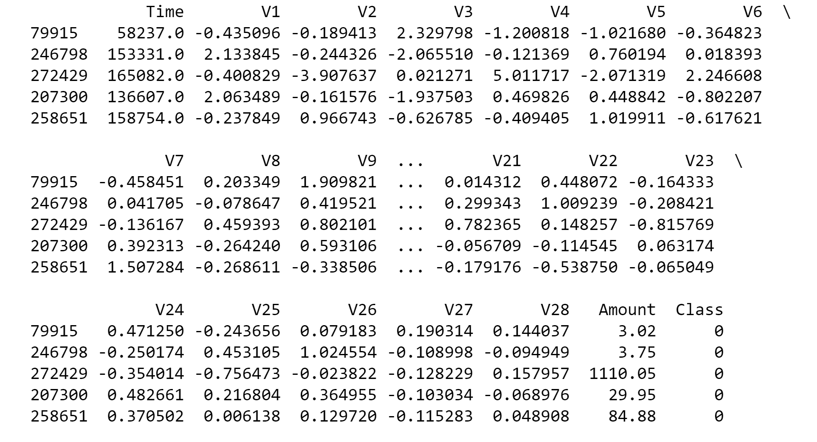

Slide 6
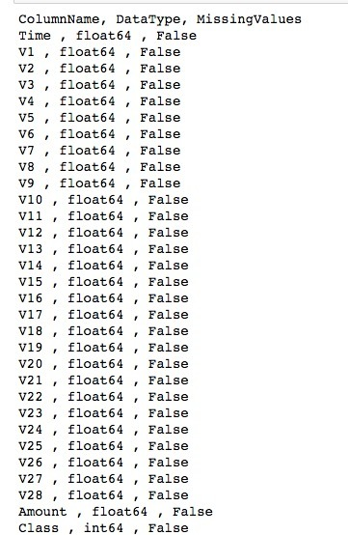
CHECKING FOR MISSING VALUES
DATA CLEANING
DATA CLEANING

Slide 7
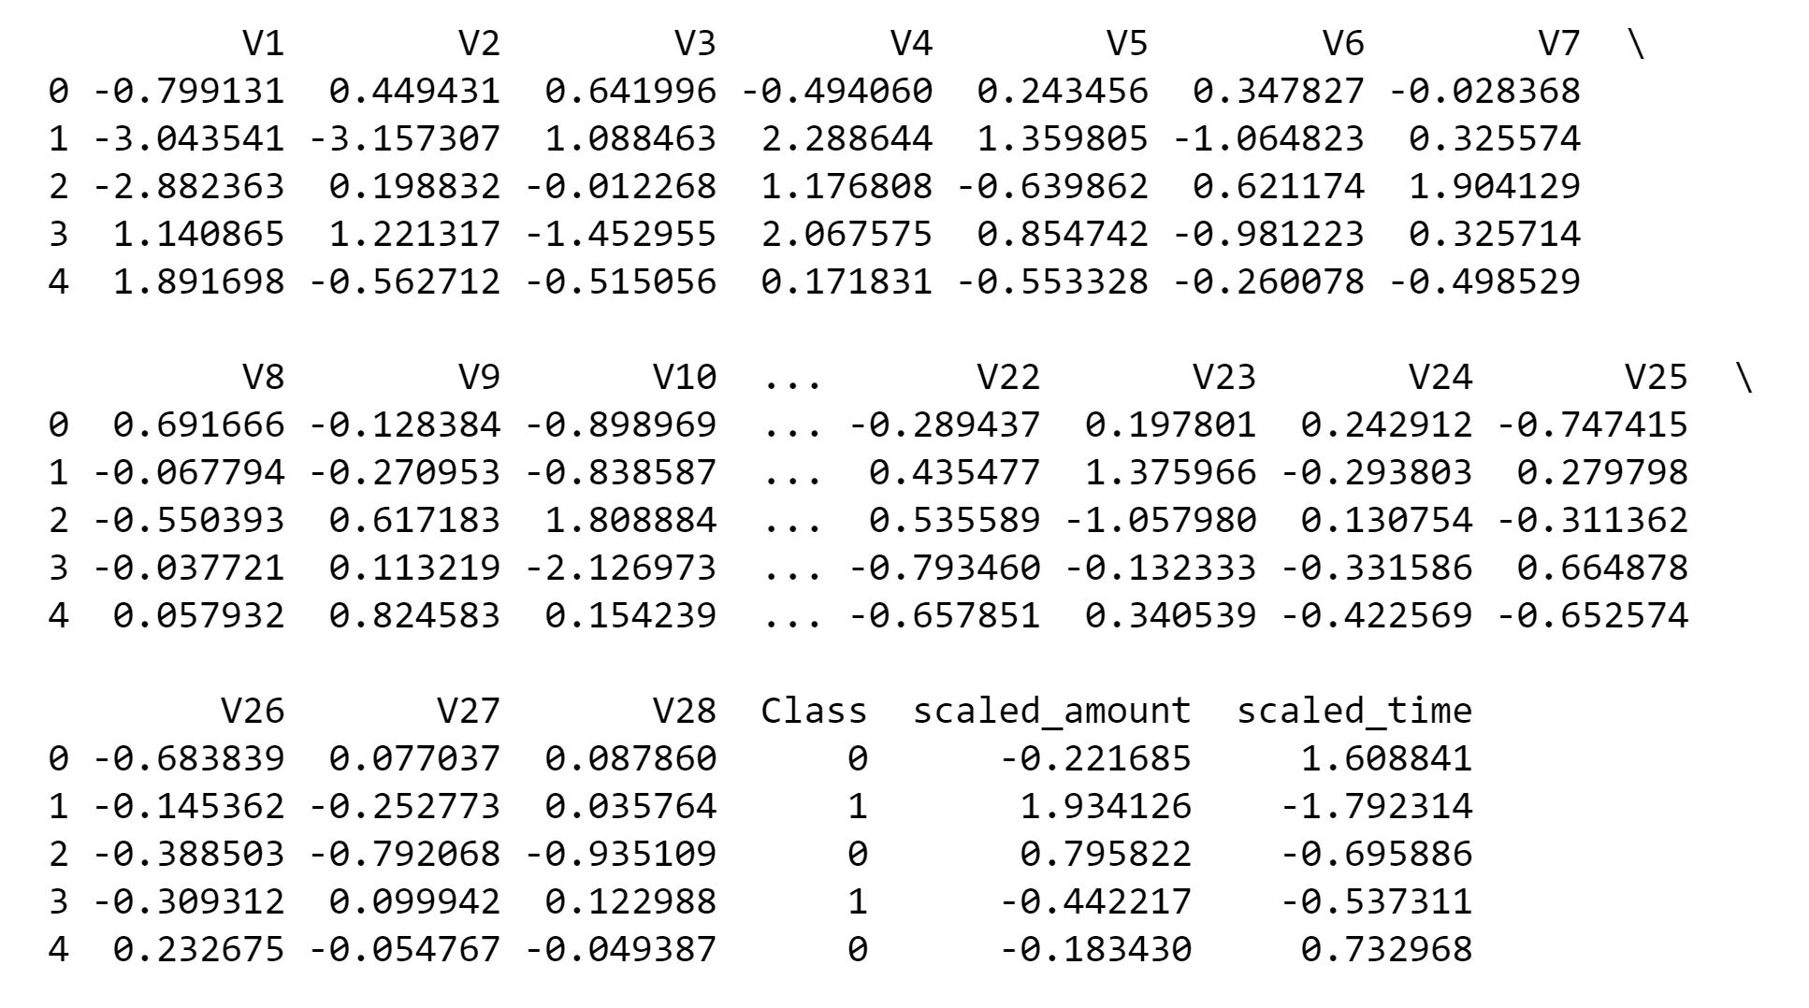
SCALING “AMOUNT” & “TIME”
DATA TRANSFORMATION
DATA CLEANING

Slide 8
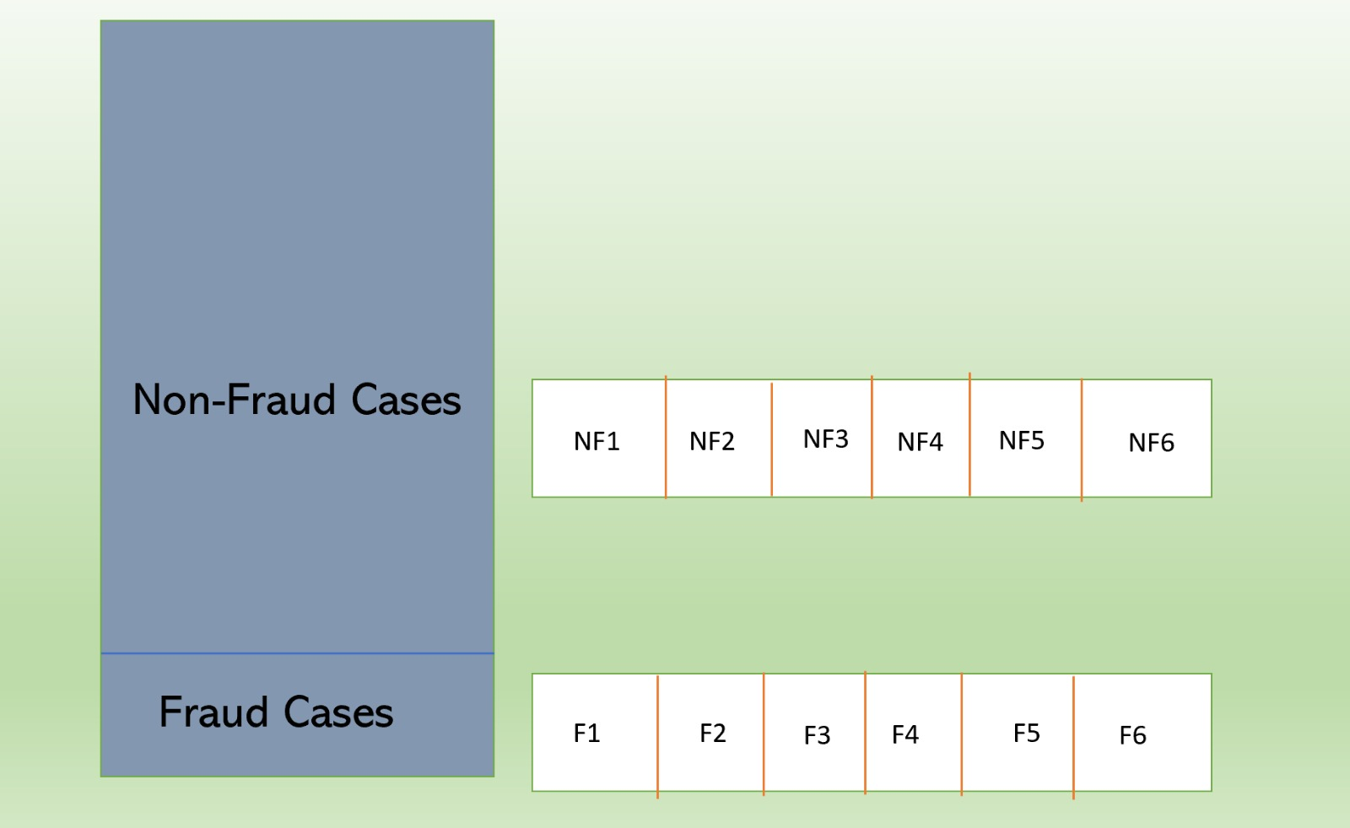
Dividing Fraud and Non-Fraud in Folds
DATA SOLUTION
FOR IMBALANCE
ISSUE
DATA CLEANING

Slide 9
DATA MINING PATTERNS- METHODS & PROCESS

Slide 10
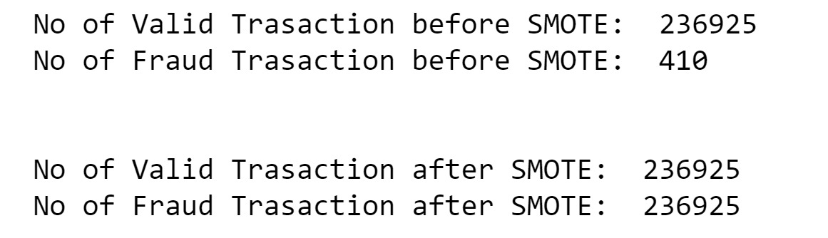
SMOTE (ARTIFICIAL/SYNTHETIC DATA)

Slide 11
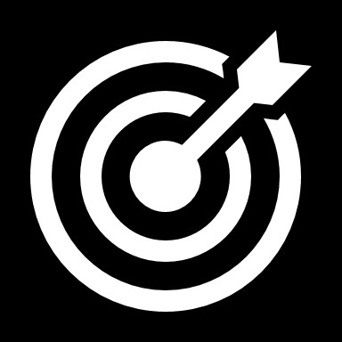
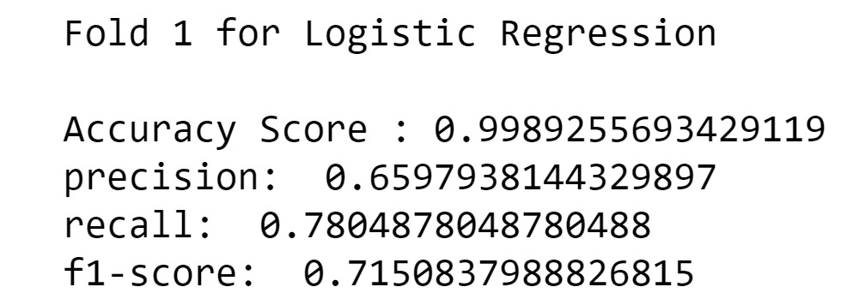
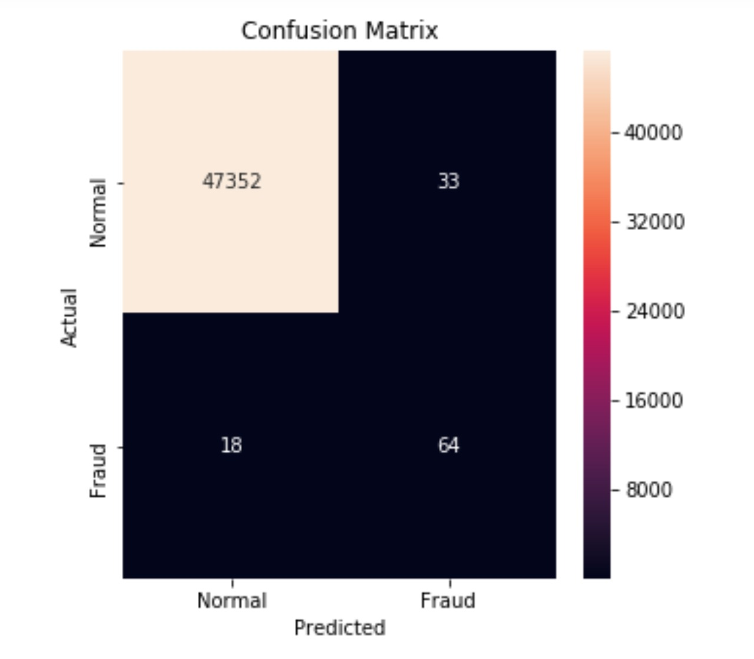
01
FOLD
LOGISTIC REGRESSION
Model's Accuracy
LOGISTIC REGRESSION

Slide 12
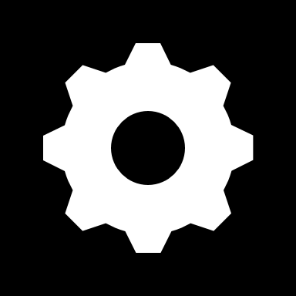
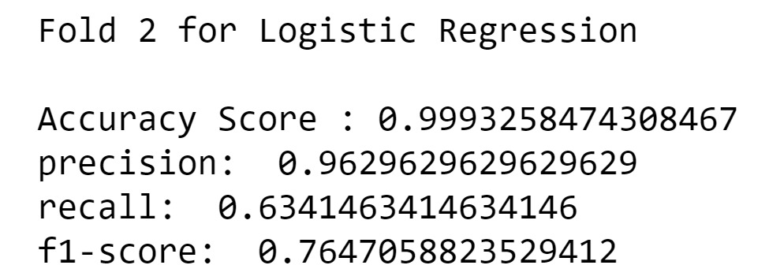
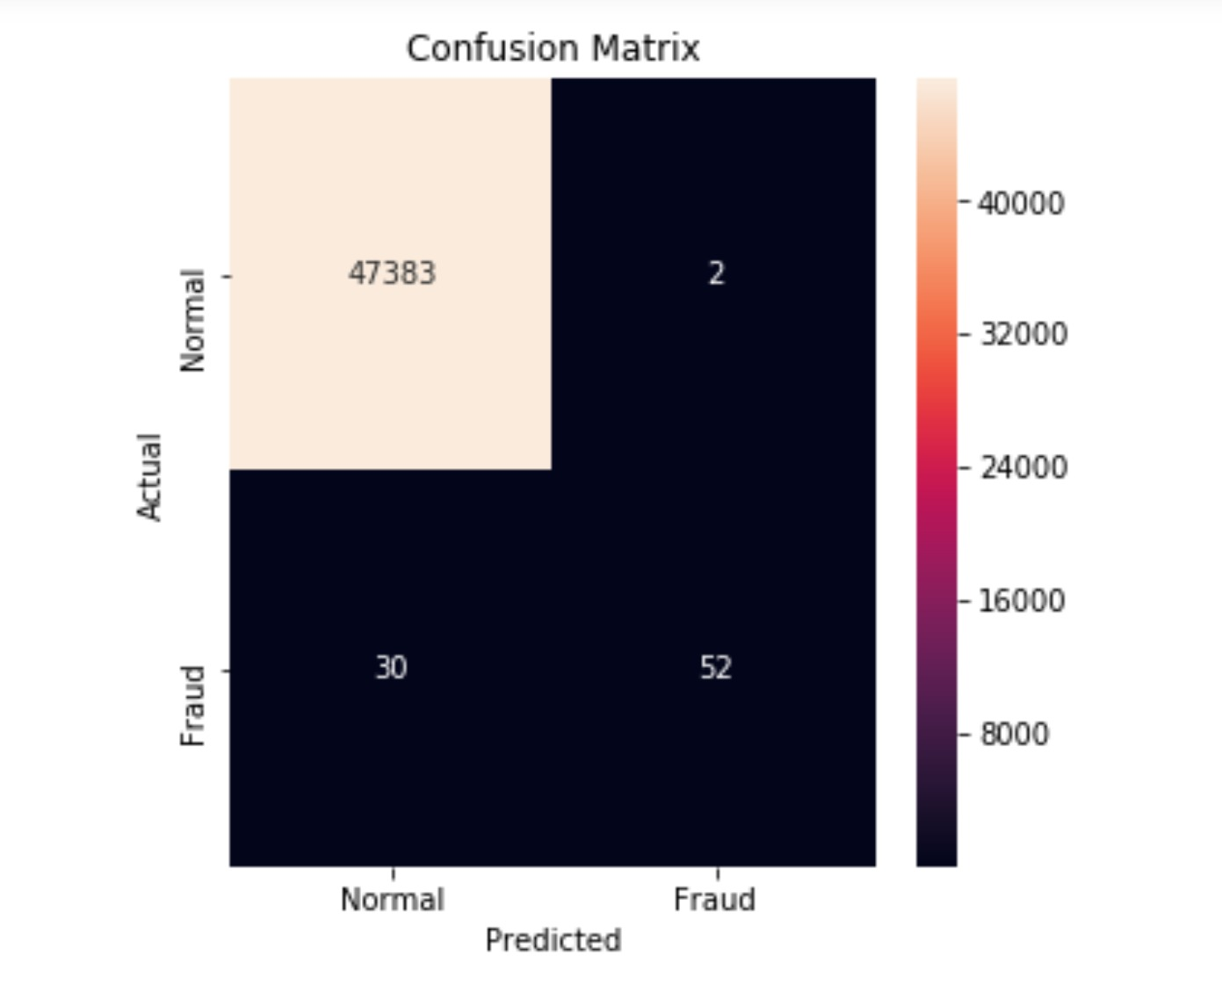
02
FOLD
LOGISTIC REGRESSION
Model's Accuracy
LOGISTIC REGRESSION

Slide 13
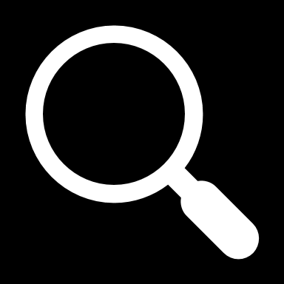
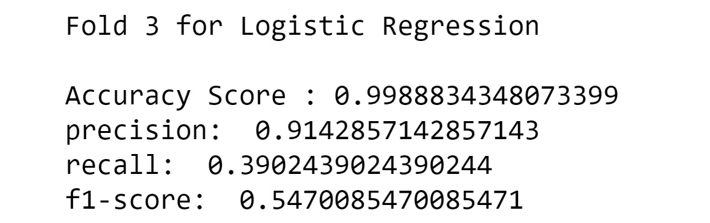
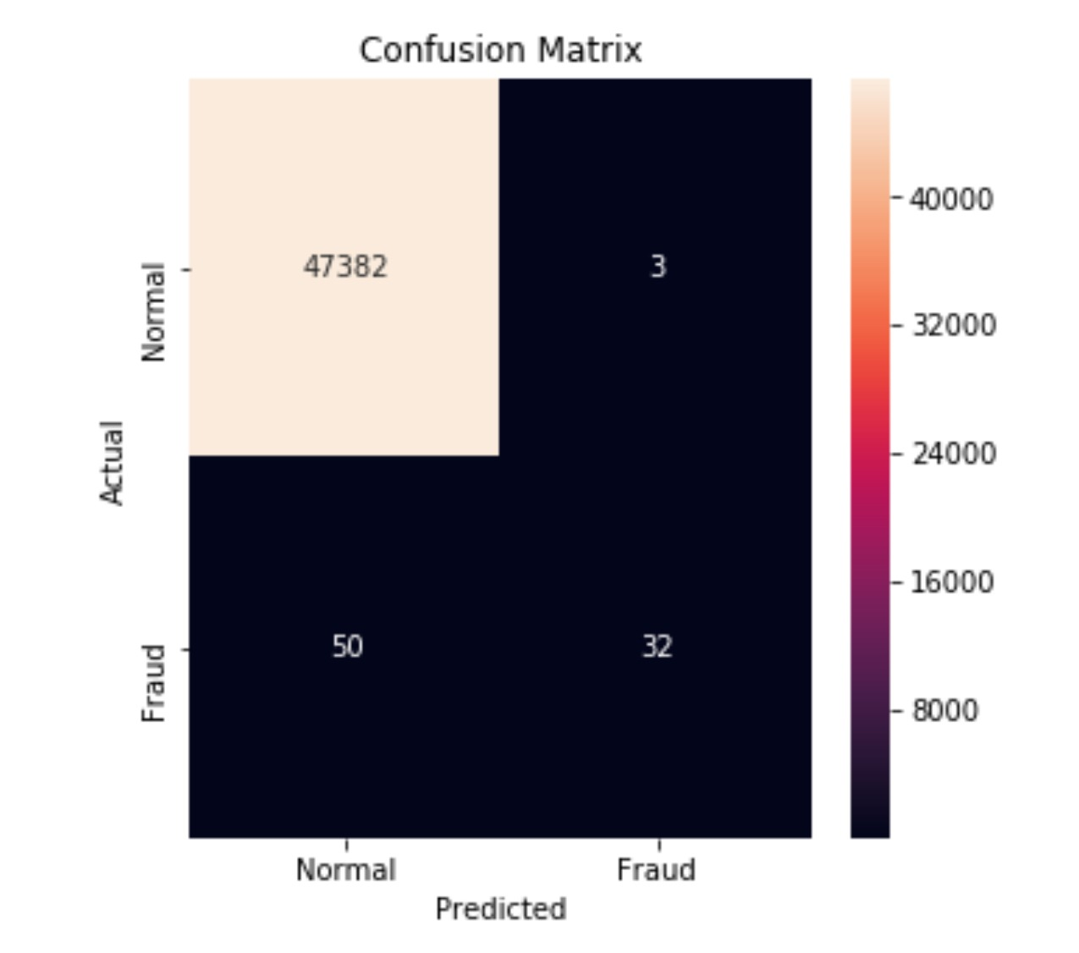
03
FOLD
Logistic REGRESSION Model's Accuracy
Logistic Regression.

Slide 14
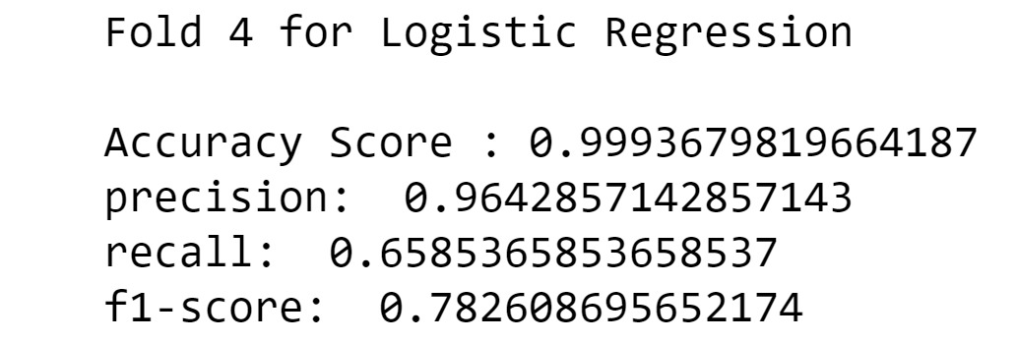
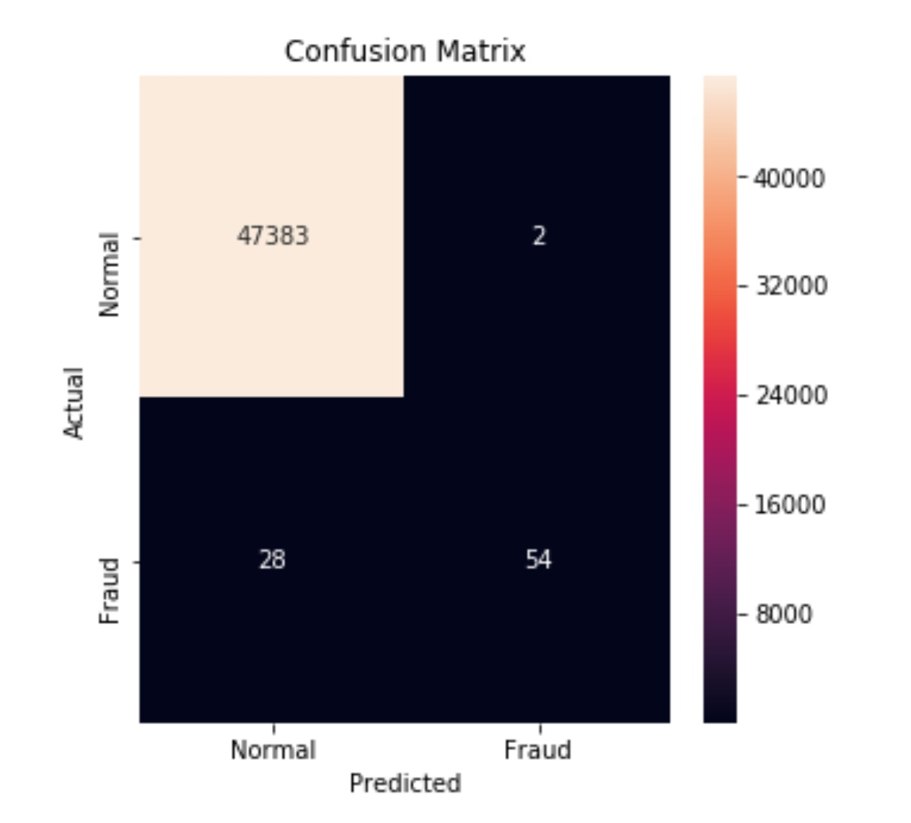
04
FOLD
LOGISTIC REGRESSION
Model's Accuracy
LOGISTIC REGRESSION

Slide 15
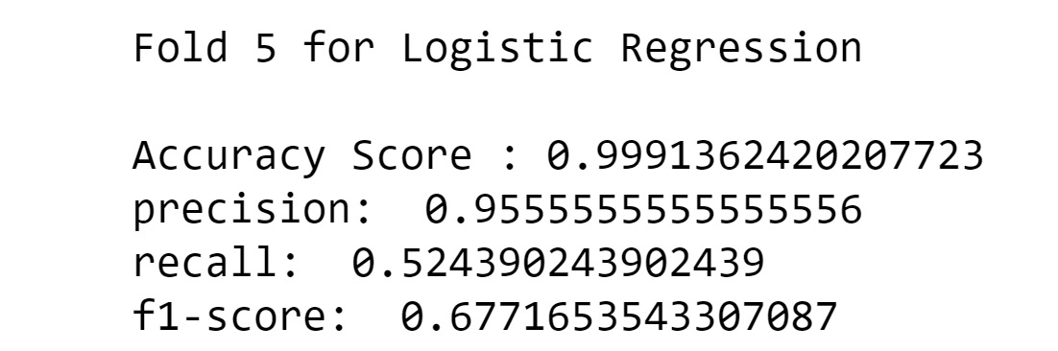
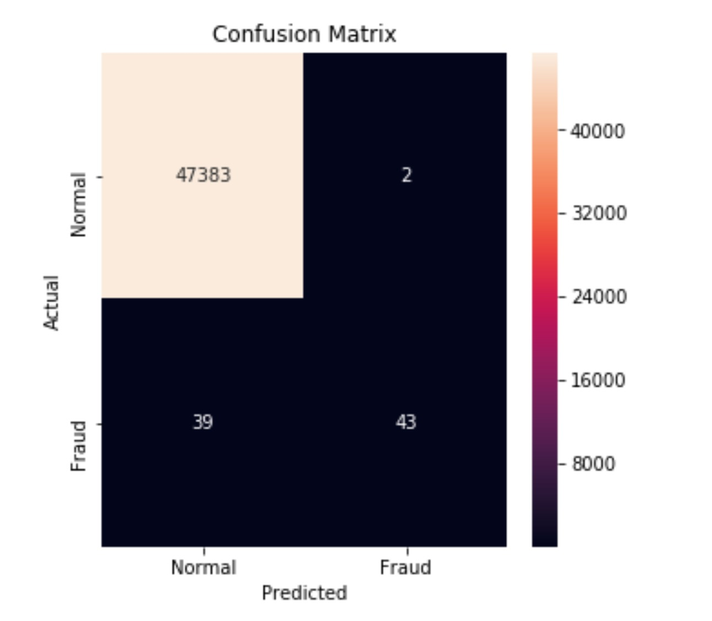
05
FOLD
LOGISTIC REGRESSION
Model's Accuracy
LOGISTIC REGRESSION

Slide 16
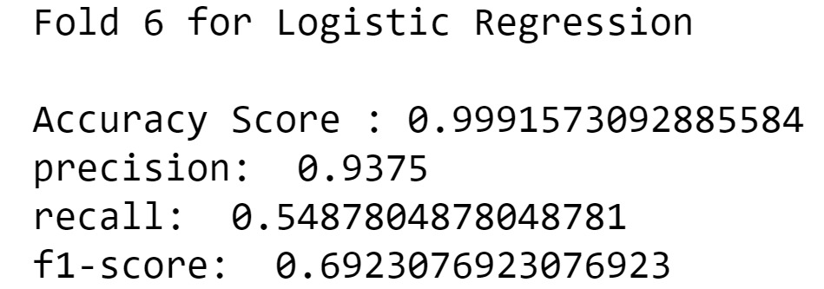
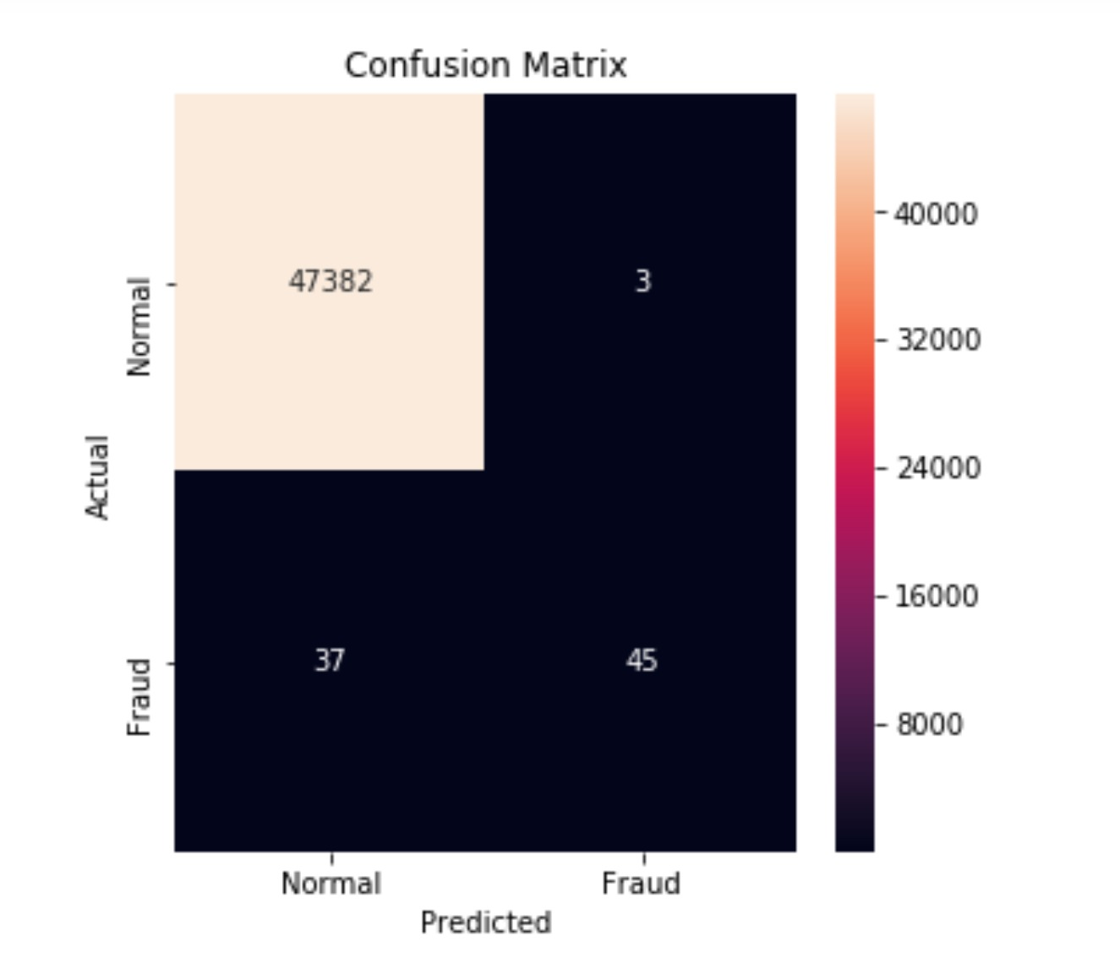
06
FOLD
LOGISTIC REGRESSION
Model's Accuracy
LOGISTIC REGRESSION

Slide 17
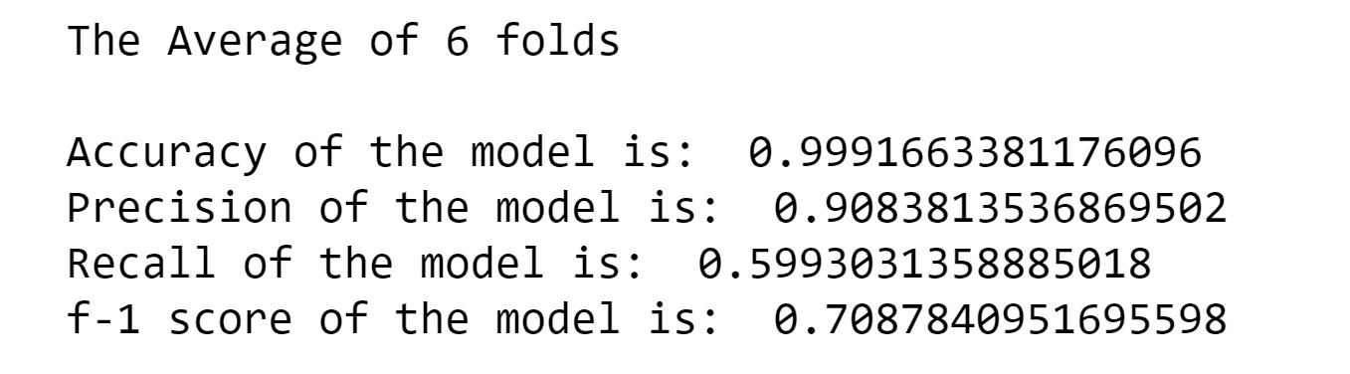
EVALUATIONS AND RESULTS

Slide 18
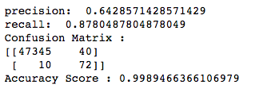
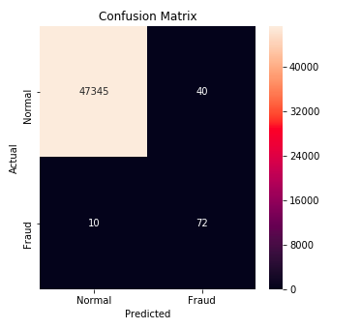
01
FOLD
KNN
Model's Accuracy
K NEAREST NEIGHBORS

Slide 19
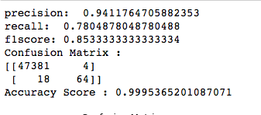
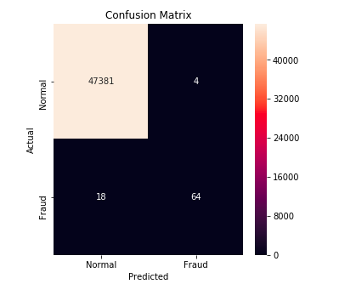
02
FOLD
KNN
Model's Accuracy
K NEAREST NEIGHBORS

Slide 20
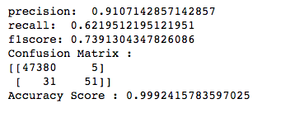
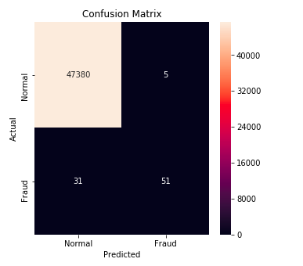
03
FOLD
KNN
Model's Accuracy
K NEAREST NEIGHBORS

Slide 21
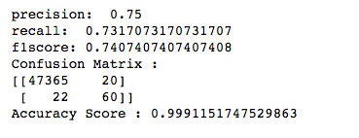
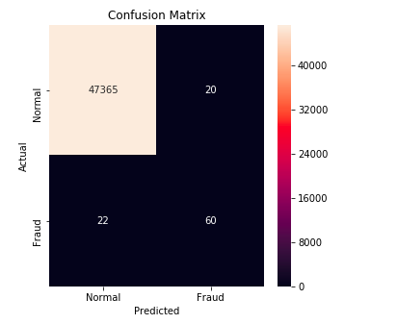
04
FOLD
KNN
Model's Accuracy
K NEAREST NEIGHBORS

Slide 22
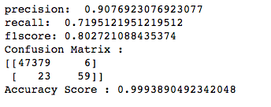
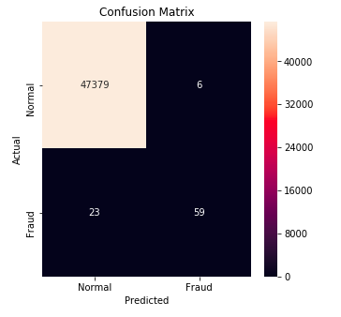
05
FOLD
KNN
Model's Accuracy
K Nearest NEIGHBORS

Slide 23
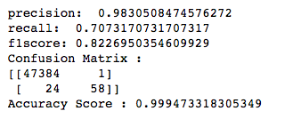
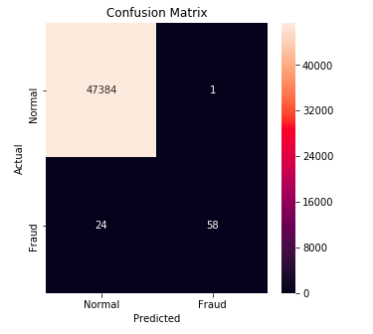
06
FOLD
KNN
Model's Accuracy
K Nearest neighbors

Slide 24

EVALUATIONS AND RESULTS

Slide 25
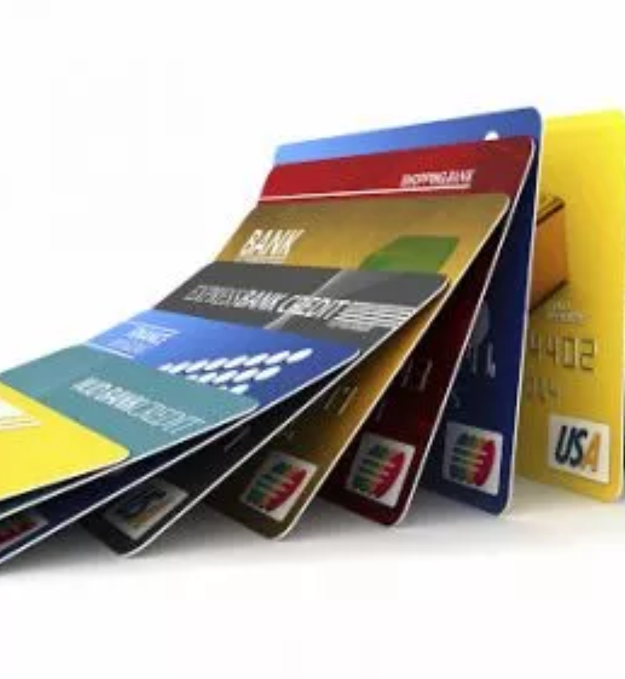
CONCLUSION AND FUTURE WORK
Out of the two classifiers, KNN model was able to produce a better result.
Looking at f1-score, 82% of the time we are going to detect the fraudulent transactions

Slide 26
FUTURE SCOPE
This field needs so much more research, and this is one of the topics where an increase in specificity by 0.1% will save Millions, if not Billions of Dollars.
We can extend the work by building and a comprehensive tuning of Random Forest algorithm as outputting the feature importance would enable one to see what specific factors are most important for detecting fraudulent transactions.
Implement different sampling techniques to over come imbalance issue, like cluster - based over sampling and bagging based sampling.

Slide 27
THANK YOU

